Slide 1









Whiteboardmaths.com
7
2
1
5
© 2004 All rights reserved

Slide 2


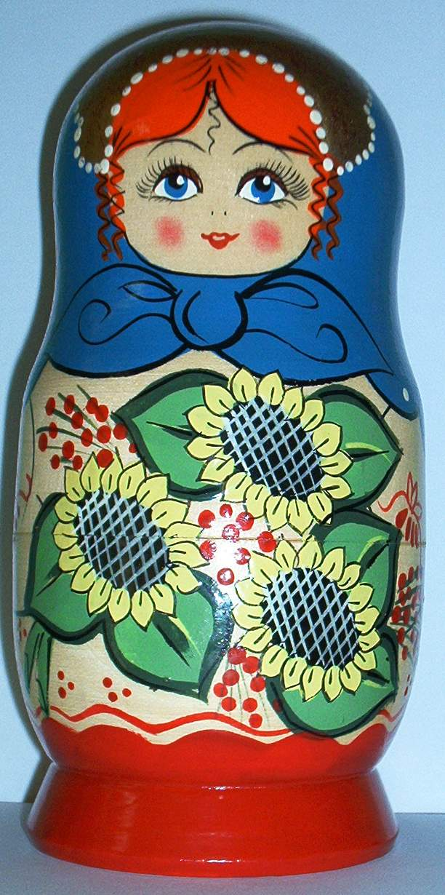
Similarity Involving 2D and 3D Shapes

Slide 3

Enlargements by scale factor x 2
1 dimensional
 |  | distances | areas | volumes
line | 3
rectangle | 2 x 3
cuboid | 3 x 4 x 2
3 units
x 2
= 2¹
x 2
= 2¹
x 4
= 2²
6 units
x 2
= 2¹
x 4
= 2²
x 8
= 2³
How have the distances, areas and volumes changed when the shapes are increased by a scale factor of x 2?
2 dimensional
3 dimensional
2
6 cm²
24 cm³
3
12 cm²
3
2
4
48 cm²
All distances are increased by 2, all areas by 2² and all volumes by 2³.
6
192 cm³
4
24 cm²
4
6
8

Slide 4
Enlargements by scale factor x 3
1 dimensional
 |  | distances | areas | volumes
line | 3
rectangle | 2 x 3
cuboid | 3 x 4 x 2
3 units
x 3
= 3¹
x 3
= 3¹
x 9
= 3²
9 units
x 3
= 3¹
x 9
= 3²
x 27
= 3³
How have the distances, areas and volumes changed when the shapes are increased by a scale factor of x 3?
2 dimensional
3 dimensional
2
6 cm²
3
3
12 cm²
24 cm³
2
4
All distances are increased by 3, all areas by 3² and all volumes by 3³.
648 cm³
9
108 cm²
6
54 cm²
6
9
12

Slide 5
In general, if two 3D shapes are similar and the scale factor of enlargement that maps one to the other is k, then the area factor is k² and the volume factor is k³.
Linear Scale Factor | Area Factor | Volume Factor
k | k² | k³
When cube A is enlarged by a scale factor of x 3 to cube B, all distances on B are 3 times the corresponding distances on A, all areas 3² times and all volumes 3³ times those of A.
B
3 cm
3√2
A
1 cm
x 3
√2
1 cm
3 cm
Side | 1 cm
Diagonal | √2 cm
Surface Area | 6 cm²
Volume | 1 cm³
Side | 3 x 1 = 3 cm
Diagonal | 3 x √2 = 3√2 cm
Surface Area | 3² x 6 = 54 cm²
Volume | 3³ x 1 = 27 cm³
x 3

Slide 6
Question: The cuboid below is enlarged by a scale factor of x 2. Complete the missing information for both tables.
A
B
2 cm
5 cm
3 cm
A
B
4 x 6 x 10 cm
Sides | 2 x 3 x 5 cm
Diagonal
Surface Area
Volume
Sides
Diagonal
Surface Area
Volume
√13 cm
2√13 cm
62 cm²
2² x 62 = 248 cm²
30 cm³
2³ x 30 = 240 cm³

Slide 7

k to k²
Example Question: The smaller design below has been enlarged on a photocopier. The enlarged shape is to be used as part of a logo on office stationery. Find the surface area of the enlarged design
4.5 cm
3 cm
Surface Area = 6 cm²
Surface Area = ? cm²
The scale factor of enlargement, k = 4.5/3 = 1.5
Therefore the area factor = k² = 1.5²
Surface area of logo = 1.5² x 6 cm² = 13.5 cm²
Not to Scale

Slide 8
Question: The smaller design below has been enlarged on a photocopier. The enlarged shape is to be used as part of a logo on office stationery. Find the surface area of the enlarged design
6.4 cm
4 cm
Surface Area = 11 cm²
Surface Area = ? cm²
The scale factor of enlargement, k = 6.4/4 = 1.6
Therefore the area factor = k² = 1.6²
Surface area of logo = 1.6² x 11 cm² = 28.2 cm² (1dp)
Not to Scale

Slide 9
k to k³
Example Question: The two cylinders below are similar. Find the capacity of the larger one.
Not to Scale
30 cm
? litres
1.8 litres
20 cm
The the scale factor of enlargement, k = 30/20 = 1.5.
Therefore the volume factor = 1.5³.
Capacity of large cylinder = 1.5³ x 1.8 litres = 6.1 litres (1 dp)

Slide 10
Question: The two cylinders below are similar. Find the capacity of the larger one.
Not to Scale
13.6 cm
8 cm
? litres
1.3 litres
The scale factor of enlargement, k = 13.6/8 = 1.7.
Therefore the volume factor = 1.7³.
Capacity of large cylinder = 1.7³ x 1.3 litres = 6.4 litres (1 dp)

Slide 11


Example Question: Find the capacity of the larger sphere (without using the formula)
Not to Scale
7.5 cm
3 cm
113 cm³
? cm³
The scale factor of enlargement, k = 7.5/3 = 2.5.
Therefore the volume factor = 2.5³.
Capacity of large sphere = 2.5³ x 113 cm³ = 1766 cm³ (nearest cm³)

Slide 12
Example Question: Find the capacity of the larger sphere (without using the formula)
Not to Scale
6.5 cm
2 cm
33.5 cm³
? cm³
The scale factor of enlargement, k = 6.5/2 = 3.25.
Therefore the volume factor = 3.25³.
Capacity of large sphere = 3.25³ x 33.5 cm³ = 1150 cm³ (nearest cm³)

Slide 13
Example Question: Find the capacity of the larger Russian doll.
Not to Scale
20 cm
10 cm
110 cm³
? cm³
The scale factor of enlargement, k = 20/10 = 2.
Therefore the volume factor = 2³ = 8
Capacity of large doll = 8 x 110 cm³ = 880 cm³

Slide 14
Question: Find the capacity of the larger Russian doll.
Not to Scale
16 cm
10 cm
110 cm³
? cm³
The scale factor of enlargement, k = 16/10 = 1.6.
Therefore the volume factor = 1.6³
Capacity of large doll = 1.6³ x 110 cm³ = 451 cm³ (nearest cm³)

Slide 15
k³ to k
Example Question: The two cylinders below are similar. Find the capacity of the smaller one.
When k is fractional we still regard the new object as an enlargement, even though it is reduced in size.
Not to Scale
30 cm
6 litres
? litres
20 cm
The the scale factor of enlargement, k = 20/30 = 2/3.
Therefore the volume factor = (2/3)³.
Capacity of small cylinder = (2/3)³ x 6 litres = 1.8 litres (I dp)

Slide 16
Question: The two cylinders below are similar. Find the capacity of the smaller one.
Not to Scale
13.6 cm
8 cm
6.4 litres
? litres
The scale factor of enlargement, k = 8/13.6
Therefore the volume factor = (8/13.6)³.
Capacity of small cylinder = (8/13.6)³ x 6.4 litres = 1.3 litres (I dp)

Slide 17
Example Question: Find the capacity of the smaller sphere.
Not to Scale
7.5 cm
3 cm
? cm³
1766 cm³
The scale factor of enlargement, k = 3/7.5
Therefore the volume factor = (3/7.5)³.
Capacity of smaller sphere = (3/7.5)³ x 1766 cm³ = 113 cm³ (nearest cm³)

Slide 18
Question: Find the capacity of the small sphere.
Not to Scale
6.5 cm
2 cm
? cm³
1150 cm³
The scale factor of enlargement, k = 2/6.5
Therefore the volume factor = (2/6.5)³.
Capacity of small sphere = (2/6.5)³ x 1150 cm³ = 34 cm³ (nearest cm³)

Slide 19
Example Question: Find the capacity of the smaller Russian doll.
Not to Scale
20 cm
10 cm
? cm³
880 cm³
The scale factor of enlargement, k = 10/20 = ½
Therefore the volume factor = (½)³ = 1/8
Capacity of small doll = 1/8 x 880 cm³ = 110 cm³

Slide 20
Question: Find the capacity of the smaller Russian doll.
Not to Scale
16 cm
10 cm
? cm³
451 cm³
The scale factor of enlargement, k = 10/16 = 5/8
Therefore the volume factor = (5/8)³
Capacity of small doll = (5/8)³ x 451 cm³ = 110 cm³ (nearest cm³)

Slide 21
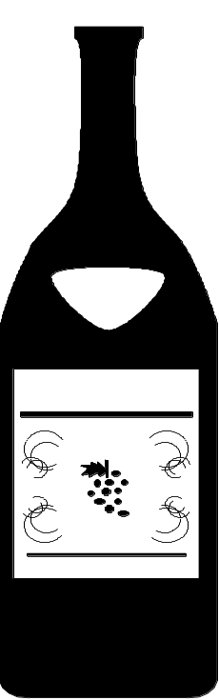
Wine 1
Question: The two bottles of wine below are similar. (a) Find the capacity of the smaller bottle (b) Find the area of the label on the larger bottle.
Not to Scale
Label area = ? cm²
Label area = 80 cm²
40 cm
30 cm
? litres
2.37 litres
(a) Comparing heights: k = 30/40 = ¾
Therefore capacity of smaller bottle = (¾)³ x 2.37 = 1 litre
(b) Area of larger label = (4/3)² x 80 = 142 cm² (nearest cm²)

Slide 22
Question: Two similar bottles of wine have the capacities shown. (a) Find the height of the larger bottle (b) Find the surface area of the label on the smaller bottle.
Not to Scale
Label area = 108 cm²
Label area = ? cm²
h cm
30 cm
70 cl
236.25 cl
(a) Comparing volumes: k³ = 236.25/70
⇒ k = ³√(236.25/70) = 1.5
Therefore height of larger bottle = 1.5 x 30 = 45 cm
(b) Area of smaller label = 108/k² = 108/1.5² = 48 cm² (nearest cm²)

Slide 23
Cone 1
Question: In the diagram below, the large cone is divided into two shapes by a plane AB that is parallel to its base. Find the volume of the larger cone.
Volume of small cone = 50 cm³
A
Comparing base areas: k² = 100/25 = 4
25 cm²
B
⇒ k = 2
Therefore volume of large cone = 2³ x 50 = 400 cm³
100 cm²
Not to Scale

Slide 24
Question: In the diagram below, the large cone is divided into two shapes by a plane AB that is parallel to its base. Find the volume of the larger cone.
Volume of small cone = 200 cm³
A
50 cm²
B
Comparing base areas: k² = 450/50 = 9
⇒ k = 3
Therefore volume of large cone = 3³ x 200 = 5400 cm³
450 cm²
Not to Scale

Slide 25
Question: In the diagram below, the large cone is divided into two shapes by a plane AB that is parallel to its base. Find the volume of the larger cone.
Volume of small cone = 135 cm³
A
Comparing base areas: k² = 90/22.5 = 4
22.5 cm²
B
⇒ k = 2
Therefore volume of large cone = 2³ x 135 = 1080 cm³
90 cm²
Not to Scale

Slide 26
Question: In the diagram below, the large cone is divided into two shapes by a plane AB that is parallel to its base. Find the volume of the larger cone.
Volume of small cone = 150 cm³
A
34 cm²
B
Comparing base areas: k² = 306/34 = 9
⇒ k = 3
Therefore volume of large cone = 3³ x 150 = 4050 cm³
306 cm²
Not to Scale

Slide 27
Cone A
Question: In the diagram below, the large cone is divided into two shapes by a plane AB that is parallel to its base. Find the volume of the smaller cone.
Comparing base areas: k² = 100/25 = 4
⇒ k = 2
A
25 cm²
B
Therefore volume of small cone = 400/2³ = 50 cm³
Volume of large cone = 400 cm³
100 cm²
Not to Scale

Slide 28
Question: In the diagram below, the large cone is divided into two shapes by a plane AB that is parallel to its base. Find the volume of the small cone.
Volume of large cone = 5400 cm³
A
50 cm²
B
Comparing base areas: k² = 450/50 = 9
⇒ k = 3
Therefore volume of small cone = 5400/3³ = 200 cm³
450 cm²
Not to Scale

Slide 29
Question: In the diagram below, the large cone is divided into two shapes by a plane AB that is parallel to its base. Find the volume of the smaller cone.
Volume of large cone = 1080 cm³
A
Comparing base areas: k² = 90/22.5 = 4
22.5 cm²
B
⇒ k = 2
Therefore volume of small cone = 1080/2³ = 135 cm³
90 cm²
Not to Scale

Slide 30
Question: In the diagram below, the large cone is divided into two shapes by a plane AB that is parallel to its base. Find the volume of the small cone.
Volume of large cone = 4050 cm³
A
34 cm²
B
Comparing base areas: k² = 306/34 = 9
⇒ k = 3
Therefore volume of small cone = 4050/3³ = 150 cm³
306 cm²
Not to Scale

Slide 31
Worksheet 1
Enlargements by scale factor x 2
1 dimensional
 |  | distances | areas | volumes
line | 3
rectangle | 2 x 3
cuboid | 3 x 4 x 2
3 units
6 units
2 dimensional
3 dimensional
2
3
3
2
4

Slide 32
Worksheet 2
Enlargements by scale factor x 3
1 dimensional
3 units
 |  | distances | areas | volumes
line | 3
rectangle | 2 x 3
cuboid | 3 x 4 x 2
9 units
2 dimensional
3 dimensional
2
3
3
2
4

Slide 33
Worksheet 3
In general, if two 3D shapes are similar and the scale factor of enlargement that maps one to the other is k, then the area factor is k² and the volume factor is k³.
Linear Scale Factor | Area Factor | Volume Factor
k | k² | k³
When cube A is enlarged by a scale factor of x 3 to cube B, all distances on B are 3 times the corresponding distances on A, all areas 3² times and all volumes 3³ times those of A.
B
3 cm
3√2
A
1 cm
x 3
√2
1 cm
3 cm
Side
Diagonal
Surface Area
Volume
Side
Diagonal
Surface Area
Volume
x 3

Slide 34
Worksheet 4
Question: The cuboid below is enlarged by a scale factor of x 2. Complete the missing information for both tables.
A
B
2 cm
5 cm
3 cm
A
B
Sides | 2 x 3 x 5 cm
Diagonal
Surface Area
Volume
Sides
Diagonal
Surface Area
Volume

